Slide 1
GREEN BPM & STANDARDS
-- MADE BY NIMIT, OMKAR BHATT AND

Slide 2

What Is Green BPM ?
GREEN BUSINESS PROCESS MANAGEMENT
The concern about the environment has been increasing, especially due the changes our planet is going through. From extreme temperatures to environmental catastrophes, the fact is that more and more clients and consumers themselves have started to be more demanding about the companies that make their products or develop their services.
This is exactly why organizations are investing in technologies that allow to reduce the environmental impact, as well as taking actions to contribute to the environment. One of these is to have a green Business Process Management, also known as Green BPM.

Slide 3

How To Implement Green BPM ?
GREEN BUSINESS PROCESS MANAGEMENT
To adopt Green BPM is to analyze business processes with the goal of making them more sustainable.
Verify the resources and supplies being used in each activity, and analyze how they may be harming the environment; and
Analyze the activities of a process to evaluate how each of them can be improved in terms of sustainability.

Slide 4
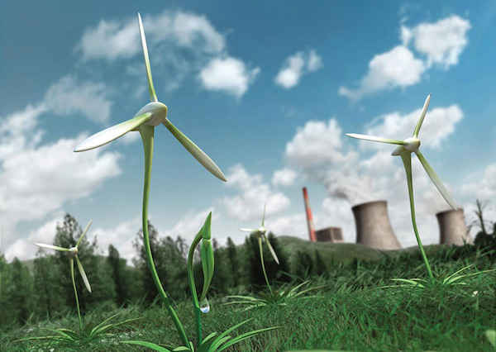
What Is Green BPM Technology ?
Business Process Management (BPM) Technology helps organisations enable business agility via process automation and optimization. Business Processes are Technology enabled via a process of continuous improvement as technology, especially IT enabled technology is ever changing and keeps evolving with time. Business Processes vary in accordance to the nature of the industry they operate in and hence technology enablement for process management is industry as well as organisation specific, tailored in accordance to needs and capabilities.

Slide 5
What is The Advantage of Green BPM ?
The most significant benefit is precisely having a company that not only uses nice words to say how concerned it is about the environment, but which, above all, does its part. This can result in more trust among employees, investors, customers, and other interested parties, increased credibility, attraction and retention of employees, increased brand recognition, and so on.
These would be good reasons to bring this green consciousness into your processes, but we can go further. For example, by focusing on reducing energy and water consumption, reducing waste, the company reduces significant costs.

Slide 6
What is The Disadvantage of Green BPM ?
Weak management and loss of funds
The benefits of the BPM framework will be fully realized only if it is implemented correctly. Failure to comply with the methodologies will result in serious loss of funds and other resources, and that is not what you want. While BPM is affordable, it is not cheap. You still have to spend a lot of money. If done right, you will get that money back in no time or see a surge in your ROI. If not, that will spell big problems for your organization. Poor information distribution can also result in poor analysis.
Limited innovations
As mentioned above, modern technology and the workforce should be utilized to their full extent when it comes to BPM. However, there are reports that organizations employing BPM are not that adept at adapting to modern technology or new trends. It is suggested that process management itself hinders innovation.
Lack of communication
Communication is key to almost everything. Some organizations are worried that BPM’s method of segregating workflows and processes might result in poor communication among the employees engaged in different fields of work.

Slide 7
Why Choose Green BPM ?
To understand why Business Process Management (BPM) is important to any business, you first have to understand what it is. This is not as easy as one might expect, since BPM means different things to different people. Every participant in a business has a different perspective and definition of BPM that is influenced by his or her role.
For some, BPM is all about technology. It is an evolution of application development and a means to achieve the automation of processes. For others, BPM is about optimization: a world of methodologies such as Six Sigma, Lean, CI, or TQM. For many, BPM is a way to communicate how they want work to get done as well as a way to facilitate change. And for yet others, BPM is a method to gain visibility to how things are actually working. And the list goes on

Slide 8
GREEN IS THE PRIME COLOR OF THE WORLD, AND THAT FROM WHICH IT’S LOVELINESS ARISES

Slide 9
THANKYOU
-- MADE BY NIMIT, OMKAR BHATT AND

